Slide 1
FINANCIAL AID NIGHT
February 6, 2019
Presented by
Donna Wilkoski
Director, Financial Aid
Bucks County Community College
Notes:
Master Page for Main/Starter Pages

Slide 2
Please silence your phones.
Thank you for being considerate to the people around you.
Notes:
Master Page for Main/Starter Pages

Slide 3
Tonight our
Applying for Financial Aid
Identify what is needed
What aid sources are available
What happens next
Making smart decisions

Slide 4
What Is Financial Aid?
Financial aid consists of funds provided to students and families to help pay for postsecondary educational expenses.
Grants/Scholarships (free money)
Self-Help (work, savings, etc.)
Loans
Notes:
Difference between a loan and grant?.

Slide 5
Basic Principles
Paying is the joint responsibility of the student
and parent(s), to the extent possible.
Need-based financial aid is subject to federal formula to determine financial need.
Not all families qualify for need-based aid. There is no guarantee that you will get any free money to pay for higher education.
Notes:
Don’t be discouraged with the price.
Some school have institutional aid to help meet what FA doesn’t cover

Slide 6
Where Does the Money
Come From?
Federal Government
State Government
School/Colleges
Private Scholarship Sources:
» HS counselors
» Clubs and organizations
» Employers
» Internet scholarship searches
Notes:
Apply for the scholarships on time.
Use the resources available to you.

Slide 7
Starting the Financial Aid
Process
Know what financial aid forms each school requires
ALL Schools Require:
SOME Schools Require:
FAFSA (Free Application for Federal Student Aid) after October 1 in Sr. Year – NEW this year
» Required by all schools, PHEAA,
and some scholarship organizations
STATE GRANT FORM (SGF) through PHEAA
» Required for first-year students (and may be requested for subsequent years) = after FAFSA is completed
CSS Profile required by some postsecondary schools and scholarship organizations
Institutional financial aid forms
Internal school forms
Notes:
Know what forms are required.
Some schools require more than the FAFSA

Slide 8
FAFSA – Free Application for
Federal Student Aid
FAFSA.gov
FAFSA is the primary federal form for financial assistance to attend postsecondary school
It determines:
» Expected family contribution, need
» Eligibility for most aid programs
Must file a FAFSA to be eligible for these programs each year a student attends school
File online – Fast, Secure, SKIP LOGIC and Built-in Edits
Want practice? Visit FAFSA4CASTER
Notes:
Help is available
All schools giving federal aid require the FAFSA

Slide 9
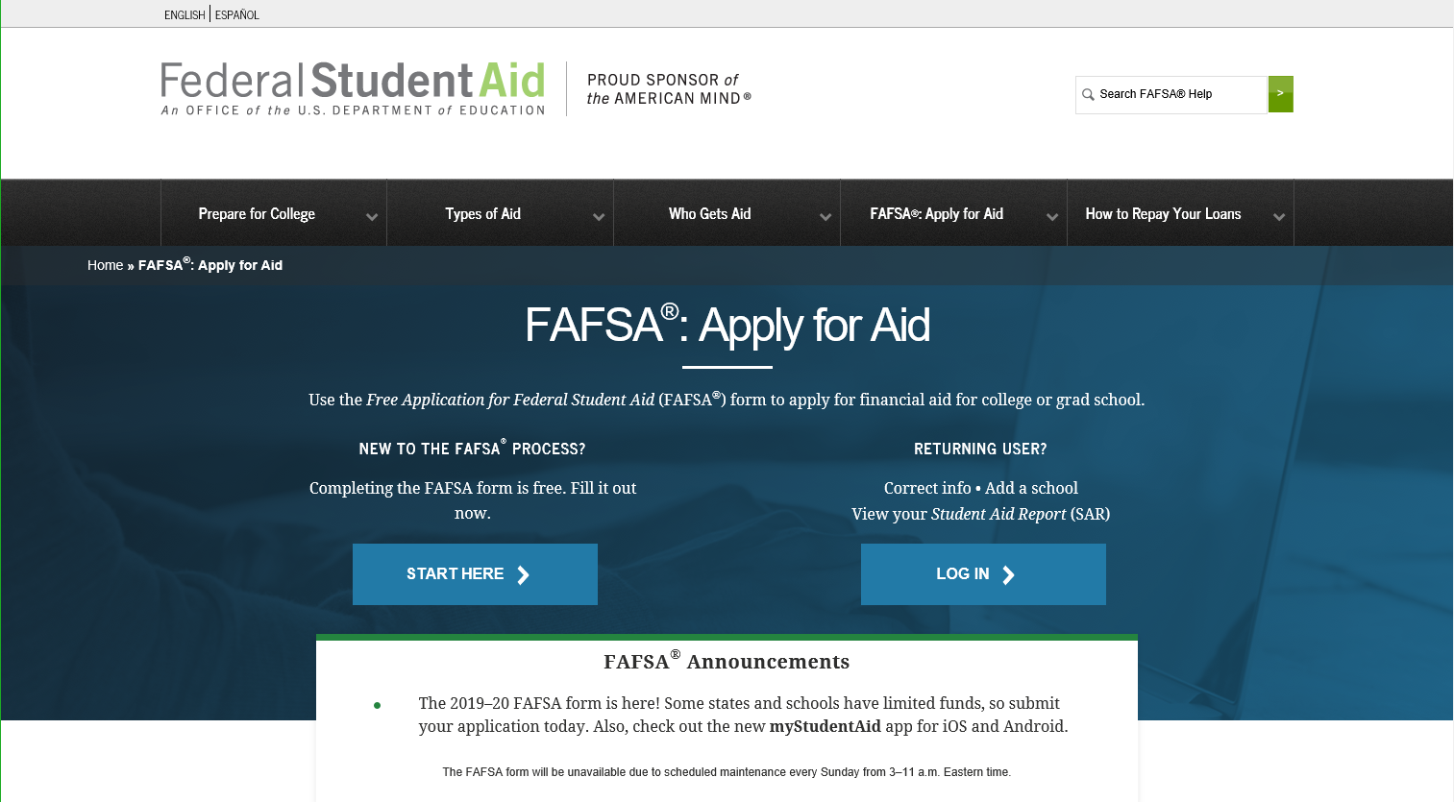
Notes:
Here is what the screen looks like.
Can save and go back
Can make corrections
Caution that there are 2 years out there now 18-19 and 19-20
Be sure that you complete the correct form
Two different emails one for parents and one for student
I suggest that the student choose an email different that his or her personal email so the parents can view. Sort of a SCHOOL information only.

Slide 10
Know When to Apply for
FAFSA & Your Deadlines!
Federal Deadlines - Apply anytime after
January 1st of the upcoming academic year
to the end of the academic year (July 1st through June 30th)
» Seniors: after October 1st 2019
School Deadlines – some WILL be earlier
PA State Grant Deadlines for FAFSA
» May 1, 2019– First-time and renewal students attending colleges, universities & college transferrable programs (excluding community colleges)
» August 1, 2019 – First-time students attending community college; a business, trade or technical schools, hospital school of nursing; Open Admissions Institutions or a 2-year non-transferrable degree program at a Jr or 4-year college.
Notes:
Abide by the deadlines
Know what they are
Some schools have early deadlines for first year students
Enticing the freshmen to come to their school, early packaging-
Estimates until the rules are set, and verification items are identified
Could change

Slide 11
Whose Info Goes on the FAFSA?
Divorced or separated parents (The parent the student lived with the most over the past 12 months. If equal, then the parent who provided more than 50% of student’s support)
Stepparents - YES
Adoptive parents - YES
Foster parents - NO
Legal guardians - NO
Anyone else the student is living with - NO
Notes:
No Grandparent information if the student is not legally adopted by the grand parents

Slide 12
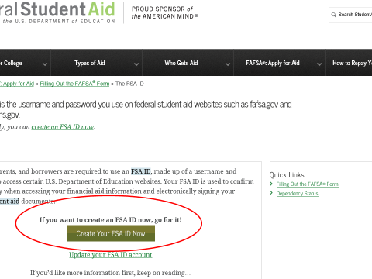
Electronic
Signature:
Create an FSA User ID and Password:
Student and one parent will sign
the FAFSA electronically - each needs a SEPARATE email address and ID/password
A verification process delays use – Get your ID/password early
Must have separate emails Parent and student
A FAFSA IS NOT COMPLETE UNTIL SIGNED!
You’ll use it again for:
Renewal FAFSA
FAFSA status and corrections
Signing a Direct Loan Master Promissory Note (MPN)
Complete required entrance and exit loan counseling
Review loan history at
NSLDS.ed.gov
Notes:
Signing the FAFSA electronic
FSA ID
Most painful part of the process
People forget,
People don’t remember what questions, etc.
Can get to it at the bottom of the FAFSA application

Slide 13
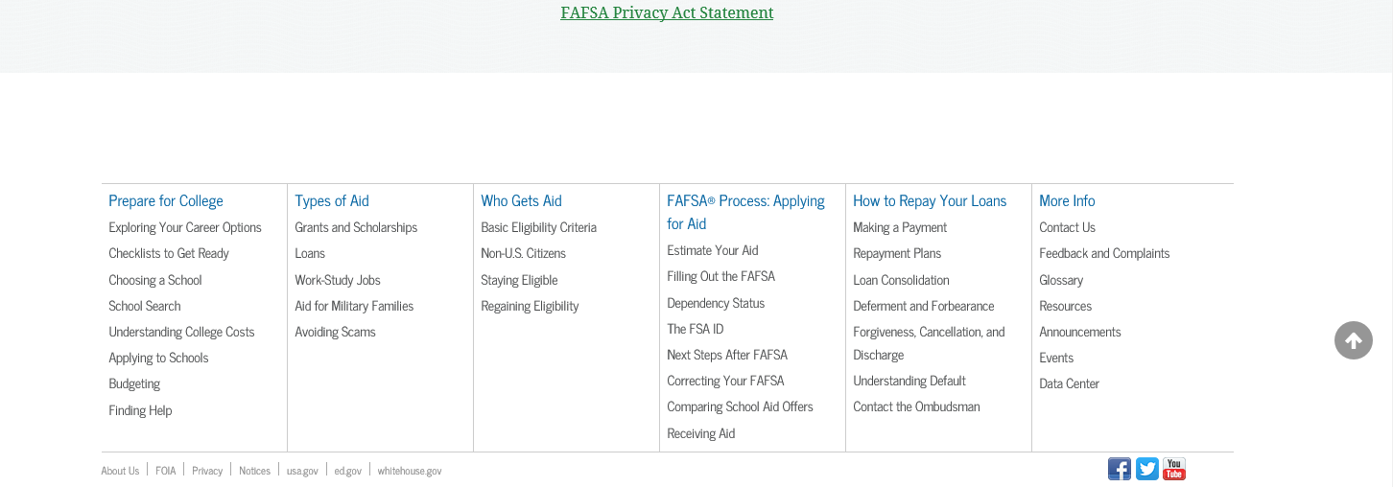
THE FSA ID LOCATION

Slide 14
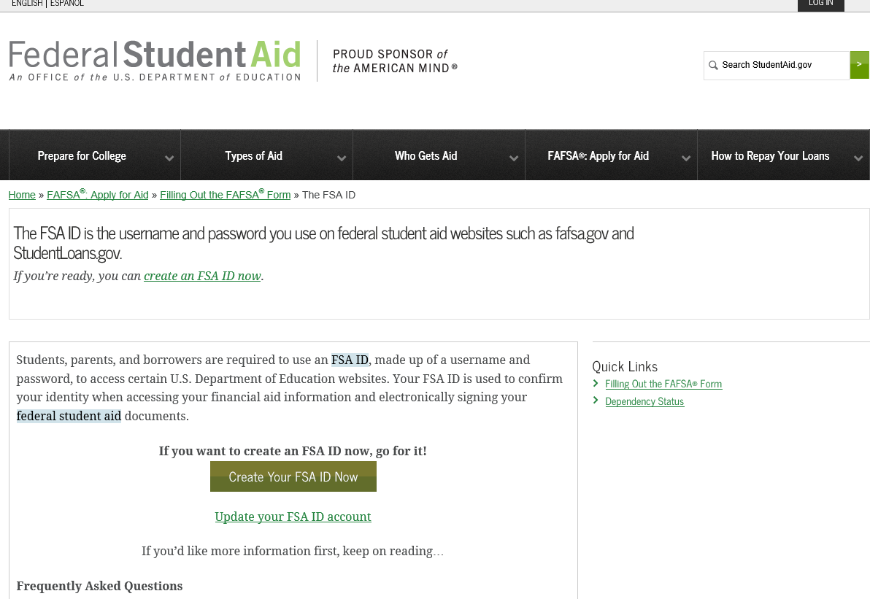
Notes:
One for each
Parent
Student
Parent can use one they have for other siblings

Slide 15
IRS Data Retrieval Tool (DRT)
The IRS Data Retrieval Tool allows students and parents to access IRS tax return information needed to complete the FAFSA. Students and parents may transfer the data directly into their FAFSA.
IRS Data is available:
» After 2 weeks of electronically filing federal tax return
» After 8 weeks of filing a paper federal tax return
» If student used estimated income to complete FAFSA, can go back once taxes are filed and use IRS Data Retrieval Tool.
Notes:
Easy for verification
Only have to update a few questions on the FAFSA
If you can use it- the IRS DRT
Not able to use DRT
Married and filing separately
Married and filing as head of household
FAFSA marital status does not match PPY IRS tax status
Filed a Puerto Rico or foreign tax return
Name and address must match exactly how it is on your tax form

Slide 16
FAFSA Completion Page
Apply for your State Grant from the FAFSA Completion/Confirmation page
Start your state application to apply
for Pennsylvania state based financial aid
TRANSFERS FOTW data to the State Grant Application

Slide 17
Online State Grant Application
Link off the FAFSA Application Confirmation Page
» Missed the link or it wasn’t available?
Link in an email sent to student/parent from PHEAA, OR
Go to PHEAA.org; State Grant Program; and complete the form
Additional questions needed to determine PA State Grant
eligibility:
» Enrollment status (full-time/part-time)
» Value of PA 529 College Savings Program
» Program of study for students in vocational programs
» Employment status
Help screens are available for all questions

Slide 18
PA State Grant Form
Students who click on the link will be automatically moved to the PA State Grant Form and will be presented with the additional questions needed to determine State Grant eligibility which includes such items as enrollment status, value of PA 529 College Savings Program, program of study, and employment status.
New for this year: The state will use your FSA ID for the signature, no need to print and submit, can submit electronically.
Students will be able to view their status on Account Access at PHEAA.org about 3 days after completing the FAFSA online.

Slide 19
Federal and State Grant Programs
Notes:
Master Page for Main/Starter Pages

Slide 20
Federal Programs
Pell Grant (2019-20 max award $6,195)*
Campus-based aid – amounts determined by FAO
» FSEOG………………… up to $4,000
» Federal Work-Study…… FAO determines
For most programs, student must be enrolled at least half-time.
* Goes to most financially needy students, estimated $ amount
Notes:
Pell is the biggest federal grant that you can receive.
Not all schools have SEOG or FWSP

Slide 21
Federal Direct
Loan Program
Based on FAFSA, students have a combination of:
Available to ALL students REGARDLESS of need
Additional unsubsidized funds available for Independent & Parent PLUS denials
Subsidized = govt pays interest in school and grace status
» As of July 1, 2018 5.05% variable/fixed interest rate,1.062% fee
» Rates set every July 1st for the life of that year’s loan; fees are deducted from disbursement
AWARDED to every eligible undergraduate student
In student’s name, no collateral or credit check, must sign MPN
Available loan amounts increase in subsequent
years
No payments required while attending school & 6-month grace period
150% RULE applies – New borrowers
Unsubsidized = interest accrues in school and grace
StudentLoans.gov & school’s website!
Notes:
All students can get a loan to attend college.
Remember borrow only what you need for educational expenses.
You have to repay all money borrowed with interest and fees.

Slide 22
Federal Direct Stafford Loan
Program Borrowing Limits
Undergraduate Students |  |  | Graduate Students
Annual Limits | Dependent Students | Independent or dependent students whose parents are unable to borrow a PLUS Loan | Graduate or Professional Studies
1st Year | $5,500 Total No more than $3,500 may be subsidized | $9,500 Total No more than $3,500 may be subsidized | $20,500 each academic year Graduate / Professional students are no longer eligible for subsidized loans
2nd Year | $6,500 Total No more than $4,500 may be subsidized | $10,500 Total No more than $4,500 may be subsidized
3rd Year and beyond | $7,500 Total No more than $5,500 may be subsidized | $12,500 Total No more than $5,500 may be subsidized
Aggregate Limits | $31,000 Total No more than $23,000 may be subsidized | $57,500 Total No more than $23,000 may be subsidized | $138,500 Total No more than $65,000 may be subsidized

Slide 23
Federal Direct PLUS Loan
For parents of dependent undergrad or graduate level students
Direct Parent PLUS Loan - in parent’s name for student costs
» 7.60 % variable/fixed interest rate; 4.248% fees -as of July 1, 2018
Rates set every July 1st for the life of that year’s loan; fees are deducted from disbursement
Can borrow up to the Cost of Attendance
MUST apply each year loan is taken
No Debt-to-Income test, only lenient credit check
» Can have an endorser (co-signer)
Principal payment can be deferred while student is in school
» Interest will continue to accrue
IF denied - student is eligible for an
additional $4,000 unsubsidized loan
Must complete a FAFSA to
determine any additional aid

Slide 24
Pennsylvania State Grant*
In-state (PA) - Full-time up to $4,123
In-state (PA) – Part-time 1/2 of the FT award
Out-of-state - Up to $500 in DC, DE, MA, OH, VT, WV
Amount determined in part by the cost of the school
* Must be at least half-time to be eligible
Notes:
Has many eligibility criteria associated with the state grant program.
We have to certify before we can paid the award.
Some time the awards are paid after all other aid.

Slide 25
Other State Programs
State Work-Study - job related to major
Educational Assistance Grant (EAP) – National Guard
Chafee Education and Training Grant – co-administered with the PA
Department of Human Services
Blind or Deaf Beneficiary Grant
Postsecondary Educational Gratuity Program (PEGP)
Partnerships for Access to Higher Education (PATH)
Pennsylvania Targeted Industry Program (PA –TIP)
Ready to Succeed Scholarship (RTSS)
For details, see the PA Student Aid Guide, or visit PHEAA.org.
Notes:
Please check the web site for more information if you feel something applies to you.

Slide 26
SCHOLARSHIPS
Notes:
I know that you heard a lot of information from Jenny earlier,
But I wanted you to know some additional information

Slide 27
Types of Scholarships
Postsecondary (in-house) scholarships
Local and regional scholarships
National scholarships

Slide 28
School Scholarships
Most postsecondary schools have
internal scholarships
» Criteria varies by school
» Check their websites (financial aid, admissions)
» Note DEADLINES
High school community scholarships
» Check with your guidance counselor
» Many internal scholarships exist - note DEADLINES
Don’t forget about national scholarships
» Companies, organizations, groups

Slide 29
Scholarship Search
Tips
Start searching early
Use FREE scholarship search sites
Don’t ignore scholarships with smaller award amounts
Don’t miss deadlines
Search for scholarships every year
Check corporate websites such as Target, Walmart,
Kentucky Fried Chicken:
All have scholarship programs and you don't have to work there to get them

Slide 30
fastweb.com
Excellent site to use for searching as it is a database that pulls specific scholarships for students based on their input. It also sends email alerts when a scholarship matches the student.
Largest, most accurate and most frequently updated scholarship database.
FastWeb.com

Slide 31
Alternative/Private Education
Loans
From private lenders or financial institutions
» In student’s name/co-signers usually required
Some loan products have a co-signer release
» Can borrow up to the Cost of Attendance
» Based on credit scores and debt-to-income
» Repayment may be deferred until education completed
» Terms vary by lender – compare before making
choices
» Students must sign a “Self Certification Form” per DOE
READ THE FINE PRINT
LOANS OF THE LAST RESORT
Notes:
Some times it is cheaper than a PLUS loan but the weigh all the parts.
Do your homework
Try to get the best rates

Slide 32
FORMS ARE COMPLETED WHAT IS NEXT?
Notes:
Master Page for Main/Starter Pages

Slide 33
The process continues
Department of Education’s Central Processing System uses the information to calculate and create your Need Analysis
EFC is calculated
SAR/ISIR - reports your eligibility for aid to you and your school choices
Grant eligibility is calculated
Schools receive your results
You apply/applied to your school choices
Once accepted - schools produce Award Letters (aid packages)
You compare Award Letters
Determine true costs of school and make choices

Slide 34
What School Costs are Considered?
School costs include:
Tuition and fees
Room and board
Books and supplies
Transportation
Miscellaneous living expenses
Child care, if necessary
You can receive financial aid up to the total of the school regardless of your EFC!
Notes:
All school calculate a budget for the student types.

Slide 35
Determining Need-Based
Eligibility
Student submits FAFSA
Family undergoes Need Analysis
Expected Family Contribution (EFC) is determined based on:
» Parent income and assets
» Student income and assets
» Family size
» Number of children in college
» Age of the older parent
This is NOT necessarily the amount you will pay each year!
Notes:
Verification:
Process includes many items
Household size and # in college
Taxes
Assets
Untaxed income documents

Slide 36
How is EFC Calculated?
COA (Cost)
- EFC
= NEED
In theory, the EFC is a number calculated to measure and compare the general financial strength of all families applying for aid - it is NOT the amount you are expected to pay.
EFC formula considers a family’s taxed & untaxed income, assets, size, how many will be attending college, and age of oldest parent
» Includes allowances for taxes and focuses mainly on income
» Parent + student contribution = EFC
NOT AN ASSET: Home, personal property, qualified retirement funds, and value of life insurance is excluded from assets
Asset Protection Allowance is applied against parent’s reported assets
» EFC calculation roughly uses 5.64% of parent asset contribution and 20% of student contribution
» Student income contribution used in the calculation: 50% of amounts over $6,570
» Parent contribution divided by number of children in college at the same time
Notes:
Same for all students
Federal formula
Efc is the same at all schools

Slide 37
Calculating
Financial Need
School cost
EFC
$26,000
–$3,000
Schools/colleges receive financial aid information and calculate financial need
Financial Need
$23,000
Financial Aid Office (FAO) “packages” student based on financial need and available funding (varies from school to school)
Financial aid award letter sent to student
Notes:
Sample is an estimate only.
EFC is a constant to whatever school you attend

Slide 38
Financial Aid Award Letter
Official notification from school about financial
aid, terms and conditions
Lists the type and amount of each award to be received
Describes what must be done to accept or
reject any award
Discloses students rights, responsibilities and
academic requirements
Notes:
Can be paper, electronic
If electronic usually on the student portal
Check your email

Slide 39
Reviewing the Financial Aid
Package
After reviewing their packages, students should be
sure they know and understand the following:
» How much of the financial aid is free money?
» Which awards are based on need, and which are based on merit?
» Are there any conditions on the free money; in particular,
is there a GPA requirement?
» Will awards change from year to year?
» Will institutional awards increase as tuition increases?
» Will loans be needed? If so, how much?

Slide 40
Comparing Packages
Cost | $20,000 | $30,000 | $50,000
EFC | $ 3,000 | $ 3,000 | $ 3,000
Need | $17,000 | $27,000 | $47,000
Free Money | $ 6,000 | $ 8,000 | $18,000
Loans | $ 5,500 | $ 7,000 | $ 8,000
Work-Study | $ 0 | $ 2,000 | $ 3,000
TOTAL AID | $11,500 | $17,000 | $29,000
Gap = (Cost – Aid) | $ 8,500 | $13,000 | $21,000
Actual Cont. = (Cost – Free $) | $14,000 | $22,000 | $32,000

Slide 41
Special Circumstances
Recent death or disability
Reduced income
Recent separation or divorce
Contact the school and ask for a special consideration AND contact State Grant Division at PHEAA
Notes:
Check with the school, for special conditions maybe called income reduction, special circumstances.
Besure to notify the state grant program as well.

Slide 42
BE A SMART CONSUMER!!!
Notes:
Master Page for Main/Starter Pages

Slide 43
Ways to Reduce the Need for
Financial Aid
Graduate on Time
» 4 year for bachelor’s degree / 2 year for associate’s degree
Research and find the right school and major
» Minimize transfer and change of major
Earn college credits while in high school through AP courses, vo-tech and dual enrollment
Consider options for cutting costs (commute, take summer classes, buy used books, make smart meal plan choices)
2 + 2 Strategy (2 years at a community college then transfer credits to a 4-year school)
3 + 2 (master’s degree)
Notes:
Use your aid wisely. Repeating changing your major could result in loss of eligibility.

Slide 44
What Can You Do Now?
Student and parent apply for an FSA ID at:
» StudentAid.ed.gov/fsaid
Visit websites with free information about college, financial aid
and careers
Explore scholarship opportunities – locally, regionally and nationally
Use Net Price Calculator at schools interested in attending to get an estimate of your “net price” to attend
» Net Price Calculator available on each school’s website
Use the free online tool, FAFSA4caster, to estimate EFC and eligibility for federal financial aid
» Available at fafsa4caster.ed.gov

Slide 45
QUESTIONS ???
Notes:
Tell about FAFSA Fridays
FAFSA Completion workshops
The will start 2/22/19 and end in early April with some evenings if not able to make it during the Friday.
The slide show will be available on our website by the end of the week for reference
Chat bot
FATV

Slide 46
CONTACT INFORMATION finaid@bucks.edu 215 968-8200 voice 215 504 -8522 fax www.bucks.edu Bucks Chatbot on our webpage http://bucks.financialaidtv.com/
Notes:
Master Page for Main/Starter Pages

