Slide 1
NO BS! Ransomware: Everything you need to know.
Presented by members of The It Academy at bucks

Slide 2
Overview for Today
9:05-9:30 | The Ransomware Threat Explained
9:30 - 9:50 | How to Prevent Ransomware
9:50 - 10:00 | Break
10:00 - 10:20 | Responding to an Attack
10:20 - 10:40 | A decision makers checklist, things to ask your IT people and the answers you should hear.
10:40 – 10:50 |Why choose Bucks for Bucks for Cybersecurity Training
10:50 | Panel Q&A

Slide 3
D-Day Minus 1
https://pixabay.com/photos/teamwork-cooperation-brainstorming-3213924/

Slide 4
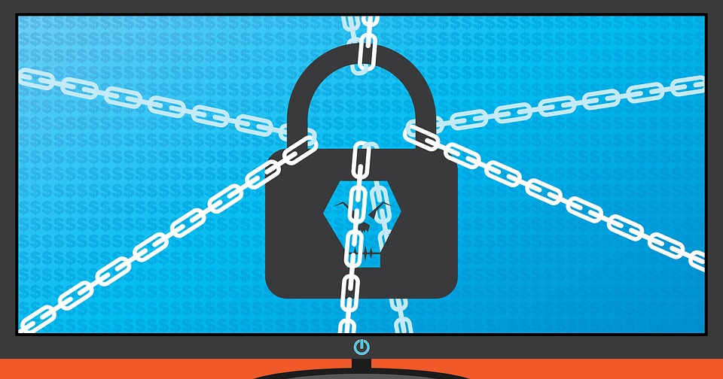
Day 0
https://pixabay.com/photos/ransomware-cybersecurity-cyber-3998798/

Slide 5
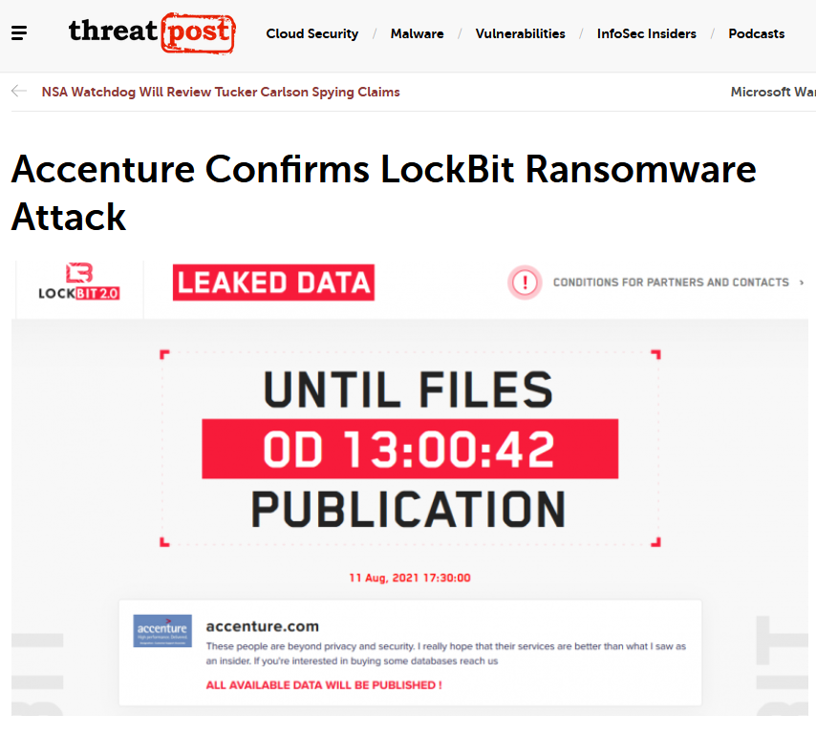
Day 1
https://threatpost.com/accenture-lockbit-ransomware-attack/168594/

Slide 6
What has the human cost been of Ransomware?

Slide 7
JBS Foods
The world's largest meat processing company said Wednesday that it paid an $11 million ransom to cybercriminals after it was forced to halt cattle-slaughtering operations at 13 of its meat processing plants. JBS confirmed the payment in a statement following a cyberattack attributed to the Russian-speaking ransomware gang "REvil."
The company ultimately paid the ransom in Bitcoin cryptocurrency to prevent further disruptions of the meat plants, mitigating potential damage to the food supply — including restaurants, grocery stores and farmers that rely on JBS production.
"This was a very difficult decision to make for our company and for me personally," said Andre Nogueira, CEO of JBS USA, in a statement. "However, we felt this decision had to be made to prevent any potential risk for our customers.“
https://www.cbsnews.com/news/jbs-ransom-11-million/

Slide 8
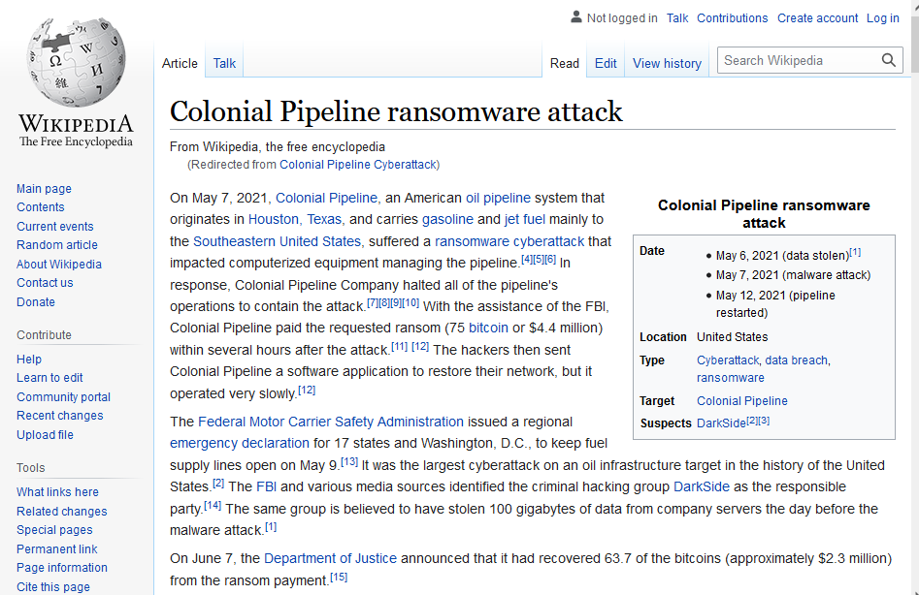

Slide 9
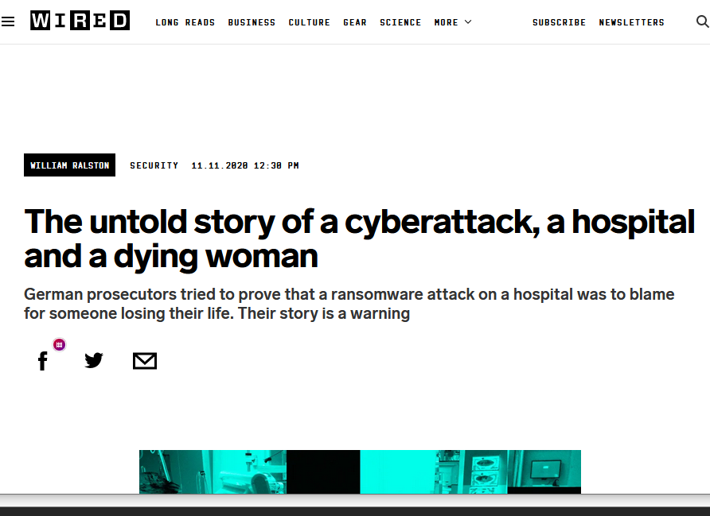
https://www.wired.co.uk/article/ransomware-hospital-death-germany

Slide 10
So what can we do?
Up Next…

Slide 11
Overview for Today
9:30 - 9:50 | How to Prevent Ransomware
9:50 - 10:00 | Break
10:00 - 10:20 | Responding to an Attack
10:20 - 10:40 | A decision makers checklist, things to ask your IT people and the answers you should hear.
10:40 | Panel Q&A

Slide 12
How to Prevent Ransomware
Scott Lynch, CCNP-S, GCDA, GNFA, GCIH, GDSA

Slide 13
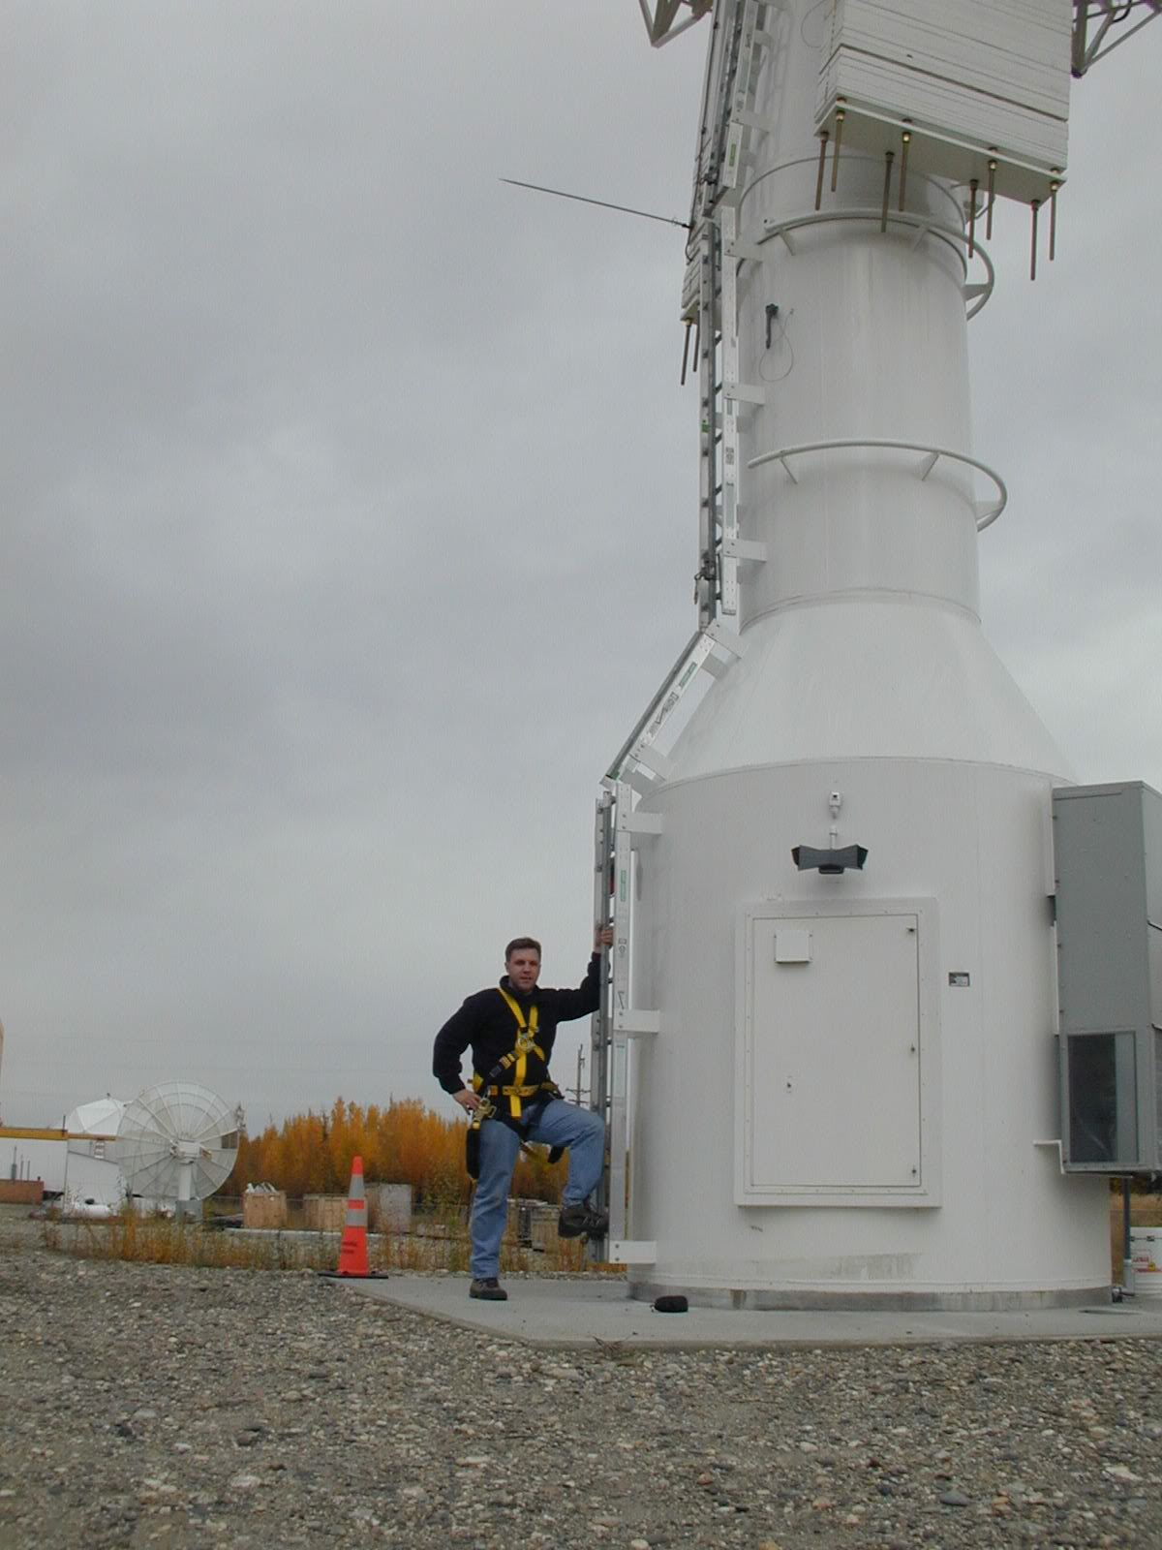
Who am I
Scott Lynch
Lynch@packetengineer.com
Twitter @PacketEngineer
SANS Instructor SEC555: SIEM with Tactical Analytics https://www.sans.org/profiles/scott-lynch/
Cisco Instructor, BCCC CCNA
Manager Security Operations, SSC Space
US Navy Veteran, Electronic Warfare/Information Warfare
CCNP-S, GCDA, GDSA, GCIH, GNFA

Slide 14
Human Operated Ransomware (HORA)
Source: Microsoft

Slide 15
Example Attacks
Merk
WannaCry
Honda
WannaCry
Colonial Pipeline
DarkSide Ransomware Gang
Mersk
NotPetya
JBS
REvil / Sodinokibi Group
Champaign-Urbana Public Health District
NetWalker
Source: F-Secure

Slide 16
Quick Wins
User Training
Risk Analysis
Application Whitelisting
Backups and DR/BC
Multifactor Authentication (MFA)
Patch Management & Vulnerability Scanning
Email Security
Attachment Filtering/DMARC/DKIM/SPF
Host Based Firewalls
Least Privilege
Testing

Slide 17
User Training
Users are first line of defense
Human Intrusion Detection and Anomaly Systems
User Awareness Training
HHS
SANS
Develop a program
Follow-up Annually or as new threats develop

Slide 18
Risk Analysis
What is your current risk?
Ransomware Self-Assessment Tool
How are you tracking and documenting
US CERT - CRR Supplemental Resource Guide
CDC.Gov - Risk Management Log Template
CIS Top 20 – Heard of it?

Slide 19
Application Whitelisting
NIST - Guide to Application Whitelisting
Microsoft AppLocker
Applocker Overview
A/V and EDR
Windows Firewall

Slide 20
Backups, DR and BC
You need to have a plan
Not a backup plan! A Preemptive plan
Do you have a Business Continuity Plan (BCP)
Ready.Gov BCP
Document, Implement, Test and Repeat
IBM Planning a backup and recovery strategy Checklist
Don’t assume anything!!
Who is responsible for ensuring your backups are working? You are!
Tabletop exercises are great for identifying failure points where backups can save you
9 Steps to an Effective Tabletop BCP Test

Slide 21
Multifactor Authentication (MFA)
Use MFA/2FA for external validation
VPN
Email
Cloud Services
Password Managers
Try and avoid SMS Based systems
YubiKey Even Better
Yubico
Whenever possible require a second authentication with a physical/app token
CISA.GOV Supplementing Passwords

Slide 22
Patch Management & Vulnerability Scanning
Attack surface reduction
Don’t make it easy for an attacker
Keep an eye on current vulnerabilities and patches needed to mitigate
Cisco Talos Intel Blog
FireEye Threat Research Blog
Palo Alto Unit 42 Threat Research
Develop a patch management strategy
A Practical Methodology for Implementing a Patch management Process
Creating a Patch and Vulnerability Management Program

Slide 23
Email Security and DNSSec
Attachment Filtering
Domain-based Message Authentication, Reporting & Conformance (DMARC)
DomainKeys Identified Mail (DKIM)
Sender Policy Framework (SPF)
DNS Security (DNSSec)

Slide 24
Endpoint Firewalls
Useful for mitigating lateral movement by attacker
Block SMB
Log Failed Inbound Connections
Great opportunity for detection
Enable logging for IR
Restricting SMB-based lateral movement in a Windows environment
Bonus Active Directory Best Practices to Frustrate Attackers: Webcast & Write-up

Slide 25
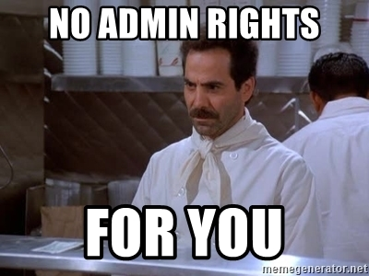
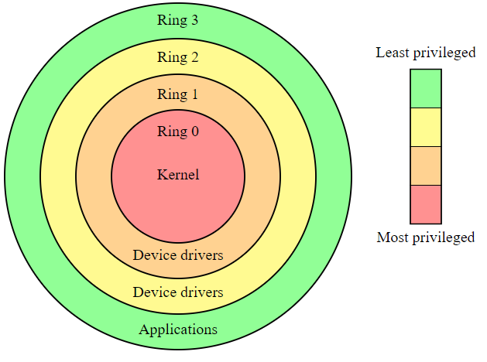
Principle of Least Privilege (PoLP)
Limit the number of rights a user is granted
Only what is necessary to do their job
https://us-cert.cisa.gov/bsi/articles/knowledge/principles/least-privilege
“Every program and every privileged user of the system should operate using the least amount of privilege necessary to complete the job.”
— Jerome Saltzer, Communications of the ACM

Slide 26
Testing
Testing of mitigation and detection
Red Team vs Purple Team
The Difference Between Red, Blue, and Purple Teams
A Blue Team's Perspective on Red Team Hack Tools
Unicorn Evangelism: The Case for Purple Teaming | Kent Icker & Jordan Drysdale | The Roundup

Slide 27
Useful Links and Material
Links of further interest
Windows Firewall
Containment Strategies
Principle of Least Privilege - PoLP
Microsoft LAPS
User Training
Data Analysis for Cyber Security 101: Detecting Lateral Movement
Human-operated ransomware attacks: A preventable disaster
Videos of Interest
Eric Conrad - Build it Once, Build it Right: Architecting for Detection
Ryan Chapman - LOCKED OUT! Detecting, Preventing, & Reacting to Human Operated Ransomware
SANS Threat Analysis Rundown - Ransomware with guest speaker Ryan Chapman
Ransomware Books
Ransomware Revealed: A Beginner’s Guide to Protecting and Recovering from Ransomware Attacks 1st ed. Edition ISBN-13: 978-1484242544
Preventing Ransomware: Understand, prevent, and remediate ransomware attacks ISBN-13: 978-1788620604
Preventing Digital Extortion: Mitigate ransomware, DDoS, and other cyber-extortion attacks ISBN-13: 978-1787120365
Ransomware Protection Playbook 1st Edition ISBN-13: 978-1119849124

Slide 28
People to follow for more awesomeness
Eric Conrad @eric_conrad
Justin Henderson @SecurityMapper
Sean Metcalf @PyroTek3
Ryan Chapman @rj_chap
Katie Nickels @likethecoins
Brian Krebs @briankrebs
Vitali Kremez @VK_Intel
Florian Roth @cyb3rops

Slide 29
Questions

Slide 30
NO BS! Ransomware: Everything You Need to Know
Responding to an Attack

Slide 31
It’s bound to happen
Notes:
The inevitable has happened and you are faced with a ransomware incident

Slide 32
Until you have experienced something like this, you don’t realize just what can happen, just how serious it can be. I had no intuitive idea on how to move forward
Maersk CEO Soren Skou

Slide 33
Incident Response Lifecycle
NIST publication 800-61 Computer Security Incident Handling Guide
Four phase approach to incident handling
Preparation
Detection and Analysis
Containment, Eradication, and Recovery
Post-Incident Activity
Some activities in different phases my happen simultaneously
Frameworks are available from other organizations such as SANS

Slide 34
Preparation Phase
Being prepared to respond to an incident is critical
Prepare plans for common types of cyber incidents
Impossible to prepare for every type of attack
Incidents not properly responded to can lead to ransomware

Slide 35
Preparation Phase
Form
Form an incident response team (CSIRT)
Create
Create playbooks and checklists
Exercise
Exercise your Incident Response plans regularly
Conduct
Conduct disaster recovery exercises to test backup efficacy

Slide 36
Preparation Checklists
Non-technical
Technical
Plan communications methods
Update call trees / on-call rotations
Network diagrams
System documentation
Temporary ”War room”
CSIRT member list
Keep offline copies of all of these!
Incident reporting software
Forensic workstations
Laptops
Forensics software
Adapters, cables, tools
Networking equipment
Blank removable media
Clean OS images

Slide 37
Additional Preparations
Be prepared to speak with the media, regulatory bodies, and law enforcement
Consider retaining Incident Response company/service
Cyber insurance companies can also assist with response
Federal, State or Local law enforcement may also help

Slide 38
Detection
Several ways to be made aware of a ransomware incident
End user reported issue
Ransom notes
AV / EDR or SIEM tool alerts
Threat intelligence or law enforcement notifications
Malware operators will often sell access to networks. Seeing these advertisements can be a good way to prevent further action being taken.
Once it is confirmed that there is a ransomware event, consider contacting law enforcement, retained IR company, or cyber insurance.
Notes:
This is the phase where it is determined whether there is an incident
Tell the stories about finding access to networks for sale on dark web and disrupting the ransomware event.

Slide 39
Analysis
Identifying the type of malware can be very helpful in understanding how it will behave and what response is recommended
Determine the entire scope of infection
Initial infection vector must be identified to prevent re-infection
Sometimes other malware involved as initial entry point
MSP can also be an infection vector
Identify whether data exfiltration has occurred

Slide 40
Containment
If caught early on, containing the infection can greatly reduce the overall impact
Isolate infected systems in a coordinated manner (more on how later)
Use out of band communications. The attacker may be monitoring email or other online forms of communication
Taking file shares or even the entire network offline should be considered
Consider taking any remote entry points such as VPNs offline until the incident is contained

Slide 41
Containment
With EDR
Without EDR
Use network contain functionality to isolate systems
Disable execution of known ransomware binaries
Gather forensic information
Remove infected devices from the network
If network contain impossible, hibernate or power off systems
Gather forensic information
Notes:
EDR tools can make containment considerably easier.

Slide 42
Eradication
Reset passwords on any compromised accounts
Remove any emails with malware from all user mailboxes
Re-install operating systems on infected systems from trusted sources
Reset passwords on any affected system
Consider organization wide password resets
Remove any persistence mechanisms
Remove malware implants (Metasploit, Cobalt Strike, etc.)
EDR tools can make this easier
Patch any vulnerabilities on internet facing systems

Slide 43
Recovery
Restore data from backup starting with most critical systems
If restore is impossible, attempt to obtain decryption keys. Law enforcement or fusion centers sometimes have them
If possible, do NOT pay the ransom
Certain scenarios you may be forced to pay (hospital with lives at risk, company survival uncertain)
Paying does not guarantee recovery of your data
Negotiate the payment. There are even services to assist with this.
Another option is to just lose the data if it is not mission critical

Slide 44
Post Incident Activities
Notification of data breach
Other regulatory reporting requirements
Lessons learned in response activities and general security practices
Update technical controls and processes to prevent future occurrences
Share indicators of compromise (IOCs) with law enforcement and fusion centers (ISACs, CISA, etc.)
Share other lessons learned to benefit the community

Slide 45
Questions?

Slide 46
NO BS! Ransomware: Everything You Need to Know PART 4: A Decision Makers Checklist Things To Ask IT and Things You Should Hear
Matthew Frederickson, MS, MBA, CISSP, CISA, ECSA,CASP+
mfrederickson@crsd.org
215-944-1092

Slide 47
The Setup

Slide 48
IT or Management
Who are you?
What is your position in the organization?
What are you RESPONSIBLE for?
What AUTHORITY do you have?
What is acceptable to you?
Breach or no breach?
Ransomware or no-ransomware
Doing ok or doing your best?
What is your budget?

Slide 49
The Foundation

Slide 50
Is Your Head On Straight
Are you doing the right things?
The strategic question
Are we doing them the right way?
The architecture question
Are we getting them done well?
The delivery question
Are we getting the benefits?
The value question

Slide 51
The Questions and Answers

Slide 52
The Perimeter Definition: The perimeter is the barrier between your network and everything else. Typically this involves firewalls, routers, intrusion detection/prevention devices, etc.

Slide 53
Are we using a Next Generation Firewall?
Listen for:
Deep packet inspection (ask if it is turned on)
Behavioral analysis (ask how often it’s updated, where the feeds come from, and how often it’s verified)
Intrusion detection/prevention (ask when and how often this is tested/updated)
Application level inspection (ask for a list of the applications detected and percentage of bandwidth used)

Slide 54
The Network Definition: Includes all aspects of network monitoring and configuration. This includes routers, switches, Virtual Local Area Networks (VLANs), etc.

Slide 55
Are We Actively Monitoring Our Network?
Listen for:
Baseline: we know what normal traffic looks like, so we can detect what abnormal looks like
Inventory: we know what devices connect to our network, when they connect, and where they go/what they do
Audit trail: we maintain records of traffic and devices so we can see what happened in the past
Types: we know what types of devices we own, and can see what connects, so we know what the anomalies are
We know who to contact, and what to do when we see anomalies – we have an incident identification and response plan in place

Slide 56
Identity and Access Management Definition: Includes user provisioning, password controls, Access Control Lists (ACL), etc.

Slide 57
Do we have strong identity standards?
Listen for:
Regular audits of accounts – we delete accounts that are no longer needed, and we audit for access privileges – folks should only get to what they need
We enforce the use of strong pass phrases
We use a strong, single-sign on service, that uses MFA
We use Access Control Lists to limit access to resources
We practice least privilege – people only have access to the resources they need
We practice:
Privileged Account Management
Identity Administration
User Activity Monitoring
Access Governance

Slide 58
Backups Definition: Includes classifying information and setting backup and recovery times, etc.

Slide 59
Can we recover from a disaster or attack?
Listen for:
Local encrypted backups for quick common recovery items (accidental file deletes, etc.)
We have local backups, and copies in the cloud
We have immutable backups (the only way to recover from ransomware)
We test and document our backups regularly (and ask to see the documentation)
We run simulations so we know what to do
We follow the 3-2-1 backup strategy
3 copies of your production data (ability to fully recover)
2 different media types (disk and cloud)
1 copy off-site

Slide 60
End Point Protection Definition: Includes all aspects of maintaining security on the endpoints, which includes computers, servers, printers, etc.

Slide 61
How are we protecting ourselves from end-point compromises?
Listen for:
We use current anti-virus/malware protection
It does behavioral analytics
It’s update every four hours (or so)
If you use Windows, you have Windows Defender enabled (it’s free and it’s from Microsoft)
We have an Endpoint Detection and Response (EDR) system
Uses REAL AI – not that fake stuff
Scans memory and STOPS ransomware BEFORE it executes
Has a sandbox
Allows you to build a baseline and WHITELIST

Slide 62
Training Definition: Includes training of all staff on information security best practices.

Slide 63
How are we enabling our employees to make smart choices?
Listen for:
Regular training – either email, webinars, in-person
Employee training is tracked – know who is being trained, on what, and when
Test, test, test – after training, make sure the knowledge sticks
Phishing emails
Social engineering
Etc.
Hold focus groups – randomly select people, at all levels, ask them what they liked and what they didn’t
Don’t over train, don’t under train

Slide 64
Administration Definition: Includes the development of policies, procedures, audits and budgeting.

Slide 65
Do we have policies and procedures?
Listen for:
We have policies which give us the AUTHORITY to protect our resources
We have procedures which assign RESPONSIBILITY and ACCOUNTABILITY for protecting our resources
We have CONTROLS in place to assure the procedures are working
We have internal and external audits to make sure the controls are correct
We use industry standard frameworks to make sure we are using best practices where we can
NIST RMF, COBIT, HITRUST, CIS 20

Slide 66
Questions?

Slide 67
Bucks County Community College STEM Department IT Academy Courses

Slide 68
Certificate of Information Assurance

Slide 69
CERTIFICATE IN INFORMATION ASSURANCE
Fundamentals of System Security
Introduction to Computer Forensics
Incident Response and Computer Forensics
Ethical Hacking and Countermeasures
Network Monitoring, Security & Forensics

Slide 70
Cybersecurity Courses and Certification
Advanced Ethical Hacking and Countermeasures
Certified Information System Security Professional (CISSP)
CompTIA Security+
CPENT - Certified Penetration Testng Professional
Certified Information Systems Auditor

